Slide 1
CPTEC-INPE status report Luiz Fernando Sapucci Coordinator of the activities on Data Assimilation Development Division of Modeling Developments DMD-CPTEC-INPE
Acknowledgements to: Carlos F. Bastarz, João G. de Mattos, Eder P. Vendrasco, Cristiano Eichholz, Ivette Banos, Renato Galante, Eduardo Barbosa, Paulo Kubota.
2nd Global Observation Data Exchange for NWP Meeting
27-30 November 2018
Notes:
1
I was invited to report an overview of current activities in data assimilation at CPTEC/INPE.

Slide 2
CPTEC participation in the GODEX-NWP
Brazil current situation (2018):
Deep economical, political and social crises:
Led to severe limitations in computational and human resources at CPTEC;
Requires an efficient way to address modeling and data assimilation issues;
Data assimilation activities at the center are being reorganized focusing the efficiency;
The CPTEC objectives at GODEX-NWP: to exchange experiences with other centers in order to explore the information contained in the data for NWP:
It is the first participation of CPTEC in the GODEX-NWP;
Overview of data assimilation activities at CPTEC;
Data base used by data assimilation;
Future plans to increase and improve our data base for data assimilation;

Slide 3
CPTEC’s mission:
The aim of center is to use global atmospheric modeling to offer the best weather forecasts over the Brazilian territory and neighboring areas to support:
Regional modeling at intermediate spatial resolution at CPTEC;
Local modeling at higher resolution and local domains (in Brazilian NWP regional centers);
In a data assimilation point of view the objective is to obtain the best initial condition by exploring all available information at observational data base taking into consideration the simulations of the CPTEC global atmospheric model.
Notes:
You know that the propose of this center is to the make global modeling to offer the best forecasts over the Brazilian territory and neighboring areas, to support:
Regional modeling and assimilation and local data assimilation at high resolutions, this last to be done in the regional Meteorological centers.
In a data assimilation point of view the objective is obtain the best initial conditions (by) exploring all (the available) information at observational data base taking into consideration the reality described by our global model.

Slide 4
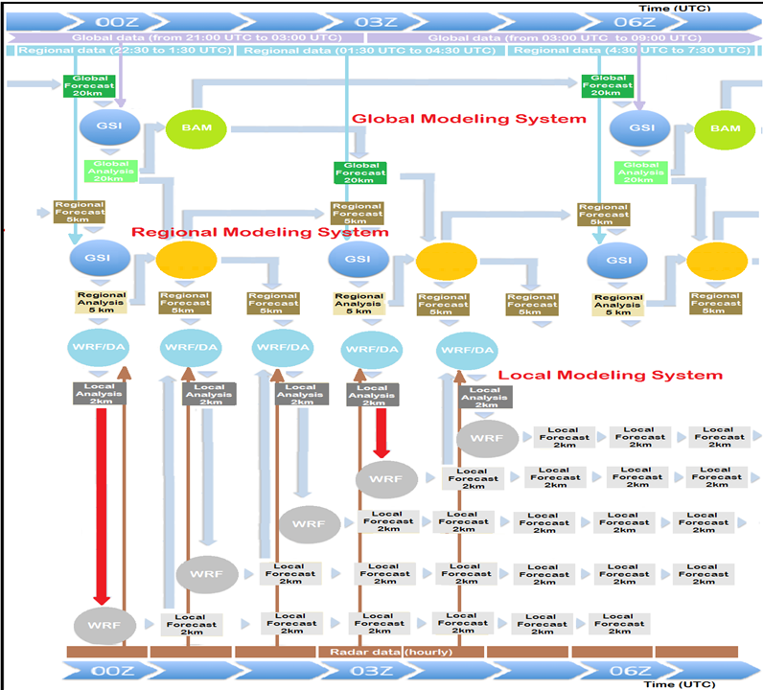
CPTEC´s
Mission
At CPTEC
Mission:
to provide the
best analysis
and forecasts
over South
America region
WRF
WRF
WRF
At Brazilian
regional
centers
supported
by CPTEC
Notes:
This flowchart shows the interaction of the different modeling systems, global and regional carried out by CPTEC to support local data assimilation (particularly radar data) in higher resolution to be done at Brazilian regional centers. This presentation will be focused in the Global Modeling System (composed by the GSI with the BAM (Brazilian Atmospheric Model) and Regional Modeling System and its development strategy.

Slide 5
Presentation contents
The use of GSI as a data assimilation system at CPTEC
SMG (Global Modeling System) [GSI with BAM]:
Code organization of different components (GSI BAM SPCON);
SMR (Regional Modeling System) [GSI with WRF]:
Interface between SMR and SMG over South America;
SMG/SMR development strategy (system evaluation tools):
Diagnostic tools for evaluation of the data assimilation process;
Observation system and analysis impact;
Current Data Usage (Observation System):
Actual data base used for data assimilation at CPTEC.
Future plans to increase data base used:
Next step: to use other observation systems not currently used in the CPTEC’s regional and global modeling systems;
Notes:
In this presentation, I would like to speak about the SMG structure and the SMG development strategy as well as the SMG schedule and its development strategy, besides opportunities and challengers for the next years in data assimilation at CPTEC to will be discussed.

Slide 6
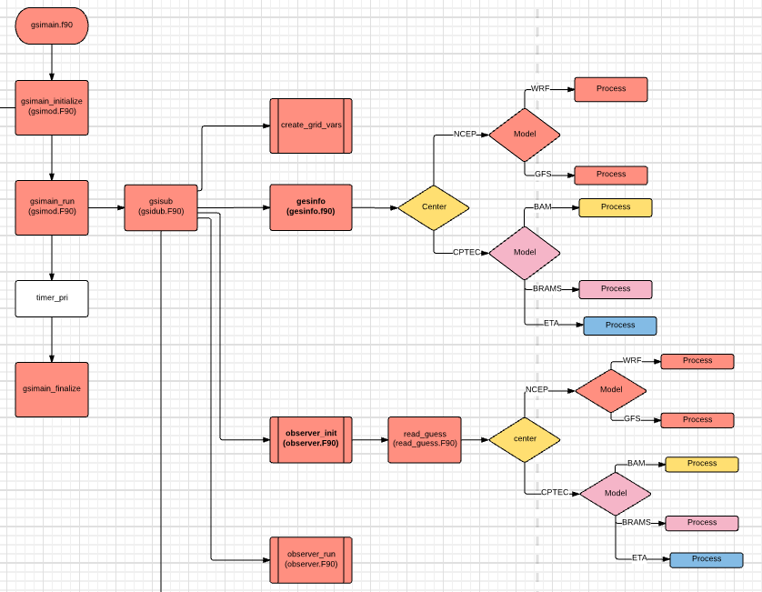
GSI in the modeling systems at CPTEC
GSI is the core of the data assimilation at CPTEC:
Original code from DTC is used and frequently updated;
All models are adapted by interface and original code is preserved;
Observed data are organized and available to be assimilated by GSI
Diagnostic files from GSI are evaluated by appropriated tools
Reading the Fisrt-guess
Global
Modeling system
Writing the analysis
Observation
system
GSI
Evaluation
system
Regional
Modeling system

Slide 7
Presentation contents
Motivation:
Objectives
Actual
Next steps to increase:
Global
Modeling system
GSI
Evaluation
system
Observation
system
Regional
Modeling system

Slide 8
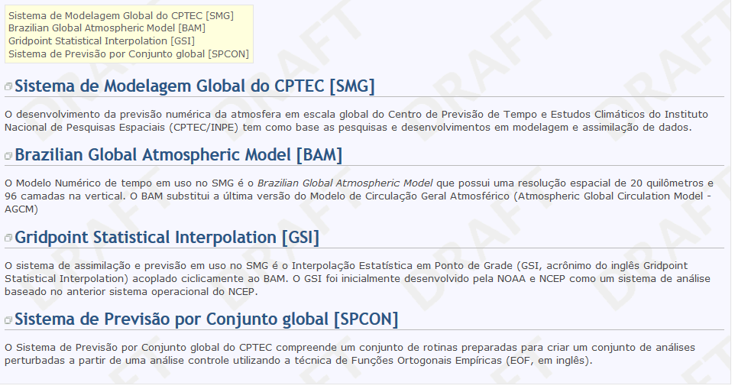
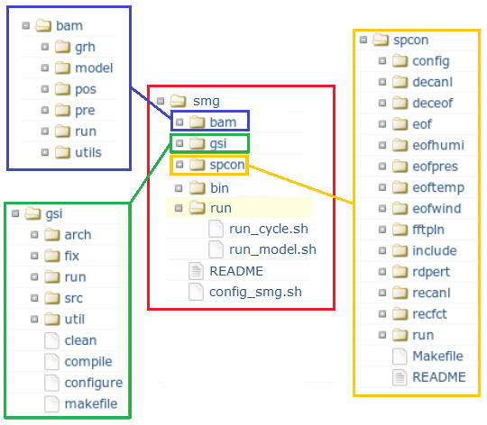
Concept of the Global Modeling System (SMG) Deterministic and Ensemble forecasting
A main project in a SVN/Redmine environment
SMG components:
Data assimilation system (GSI)
Global atmospheric model (BAM)
Global ensemble modeling system;
Current applications:
Deterministic forecasting using Var/GSI;
Ensemble forecasting;
Land Data assimilation into BAM;
Future applications (plans):
Data assimilation using EnKF/GSI;
Hybrid data assimilation using Var/EnKF;
Ensemble forecasting using ensemble of analysis generated by EnKF/GSI;
Oceanic data assimilation;
March: begin
2016 2017 2018 2019 2020
Notes:
In order to develop the ensemble activities together with the data assimilation activities under the same version control, we started to use the SVN tool to develop a big project composed by deterministic and ensemble modeling systems. The Global modeling system is composed by GSI BAM and global ensemble modeling system. The current applications of this system is Deterministic forecasting using Var from GSI; Ensemble forecasting; and Land Data assimilation into BAM. There are some future possible applications to be done using this same project, such as
Data assimilation using Ensemble Kalman Filter from GSI;
Hybrid data assimilation using Variational Ensemble Kalman Filter;
Ensemble forecasting using ensemble of analysis generated by Ensemble Kalman Filter from GSI;
Oceanic data assimilation;
We launched this big project in March 2016.

Slide 9
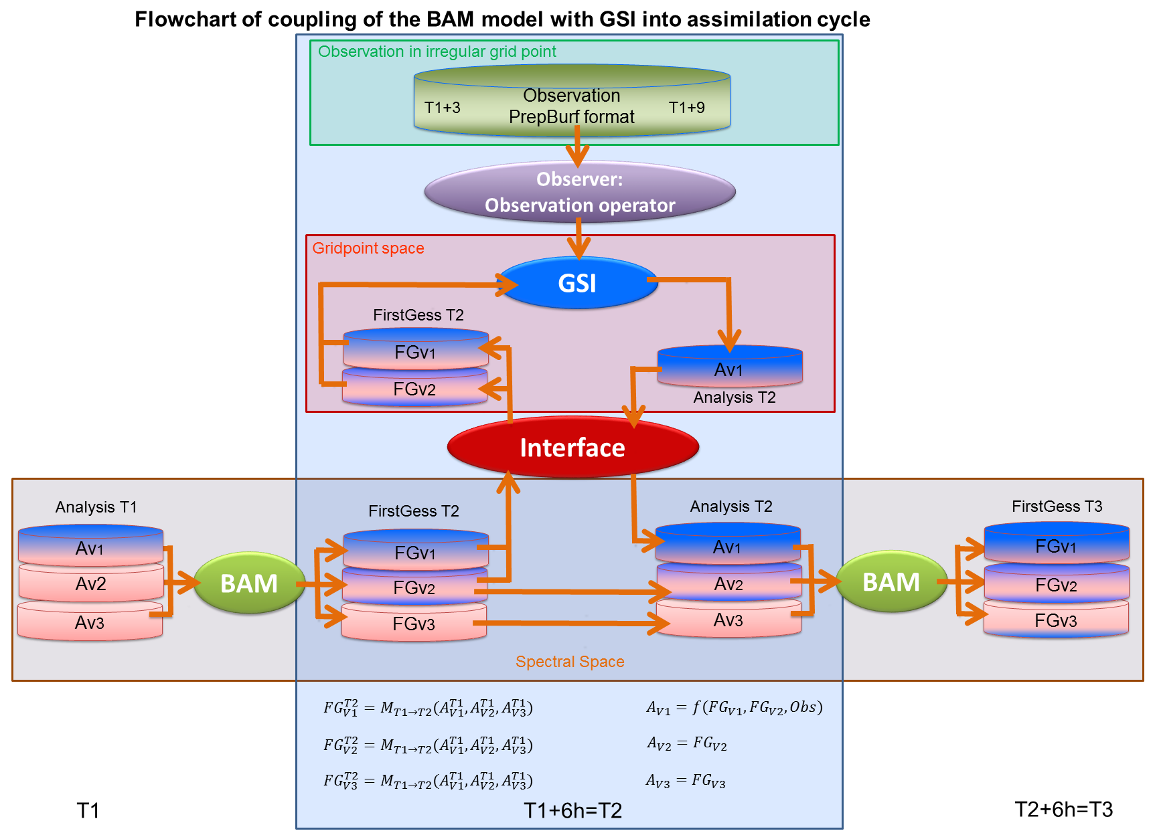
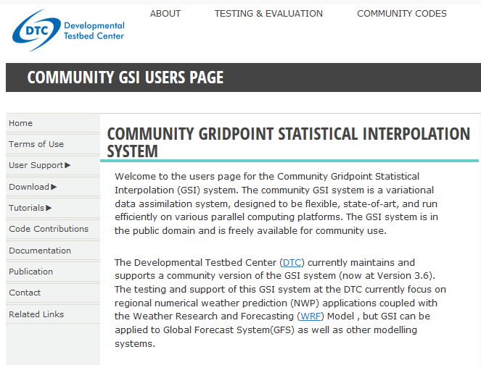
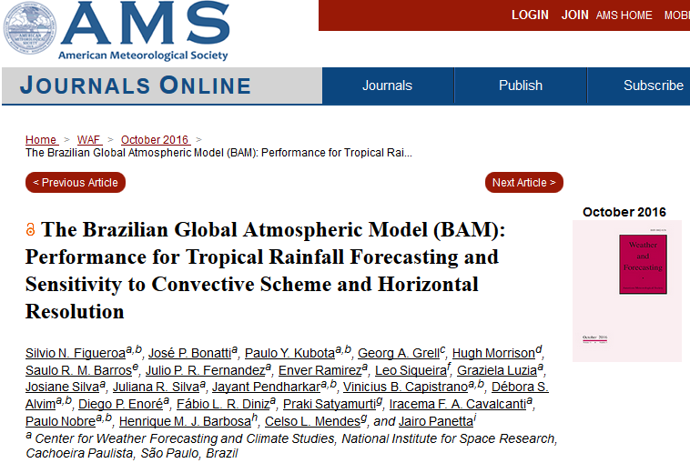
Interface between BAM model and GSI system
Some characteristics of the interface:
Independent of GSI and BAM code and enable constant updates;
Ability to use the different resolution in the assimilation process;
Conversion of spectral to gridpoint minimizing the addition of noise;
Easy to be adapted for other global models
Innovative interface between data assimilation and model at CPTEC.
Time
Notes:
This flowchart shows more details of the interface between BAM model and GSI system in different time steps of the assimilation cycle. This interface is responsible to convert the model state of the First-guess from spectral space into gridpoint space where the observations are assimilated and a new analysis is produced, which is converted to spectral space by interface. The GSI code is the same distributed by the DTC (developmental testbed center) web site and the BAM model code is the same maintained by DMD (Division of Modeling Developments) modeling group with a paper published in 2016. This interface has some characteristic that deserve attention:
It is independent of GSI and BAM code and enable constant updates of this code;
Ability to use the different resolution in the assimilation process;
Conversion of spectral to gridpoint minimizing the addition of noise;
Easy to be adapted for other global models
Innovative interface between data assimilation and model at CPTEC modeling;

Slide 10
Presentation contents
Motivation:
Objectives
Actual
Next steps to increase:
Global
Modeling system
GSI
Evaluation
system
Observation
system
Regional
Modeling system

Slide 11
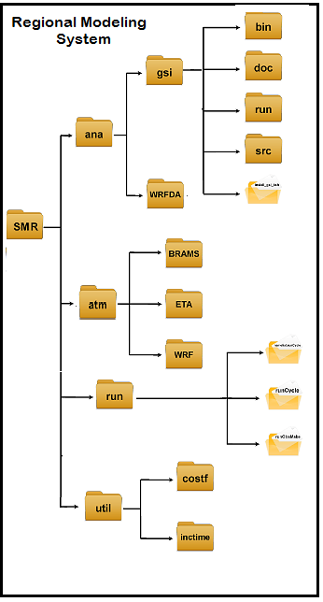
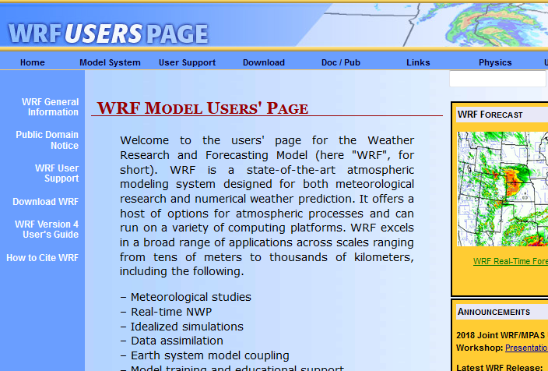
Concept of the Regional Modeling System (SMR)
Some characteristics of the system:
Different regional models can be used, such as BRAMS and ETA;
WRF is been used such as proof of concept of the regional data assimilation over South American.
GSI and Regional models are maintained independent to permit constant updates;
GSI details:
Version used: GSIv3.4_EnKFv1.0;
WRF details
Resolution 5km
Version 3.9.1.1
Domain: South American

Slide 12
Presentation contents
Motivation:
Objectives
Actual
Next steps to increase:
Global
Modeling system
GSI
Evaluation
system
Observation
system
Regional
Modeling system

Slide 13
Development strategy and deployment of the SMG/SMR
Category I: General improvements and bug corrections
1-Code optimization, and test of new resolution and high performance analysis
2-Correction of bugs and implementation of new functionalities
Category II: Monitoring and configuration of data assimilation system
3-Implementation and tests of new B Matrix
4- Adjustments in the parameters for Cost Function minimization process
5- Adjustments in variational constrains for humidity non physical values
6- Adjustments in variational constrains for Dry mass conservation
Category III: Inclusion and expansion of the used data base
7-Inclusion of conventional data
8-Inclusion of SatWind data
9-Inclusion of the GNSS Radio occultation data
10-Inclusion of Radiance data
10 different topics organized into 3 categories
Notes:
To deploy the SMG version in the operations was applied a specific strategy divided in three category. The first is about the implementation of code of the system. The second is about monitoring and configuration of data assimilation system, such as construction and test of new B matrix, adjustments in the Cost function minimization process and adjustments in the variational constrains for non physical values for humidity and dry mass conservation. The last is about the inclusion and amplification of used data base in three different types conventional, sat wind, radio occultation and radiancies;

Slide 14
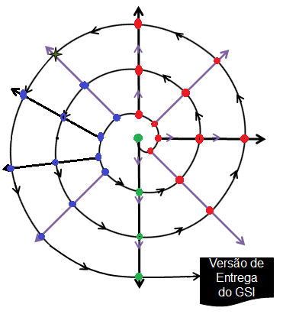
Development strategy and deployment of the SMG
Evolution of SMG system
DRY MASS
CONSERVATION
Evolution of the topic
CONVENTIONAL
COST FUNCTION
MINIMIZATION
SATWIND
CAT. III
DATA
INCLUSION
CAT. II
Monitoring and
configuration
NON PHYSICAL
HUMIDITY
ROGPS
B MATRIX
RADIANCE
Operational
version
Each topic is tackled sequentially and is revisited periodically
NUMERICAL INSTABILITY
NEW RESOLUTION
COMPUTATIONAL SKILL
CAT. I
Code and HPC
Notes:
Our strategy looks like an spiral. In this “development spiral”, each revolution covers the whole development process and it continues until all the necessary changes are checked and all the bugs are corrected. The final product is the software deployment at the operational environment. To make easier this repeated process was defined an evaluation protocol for each research line, using the available tools at CPTEC. This evaluation system is called EVAL.

Slide 15
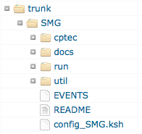
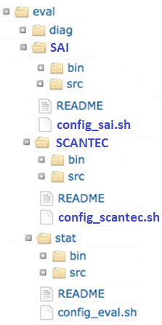
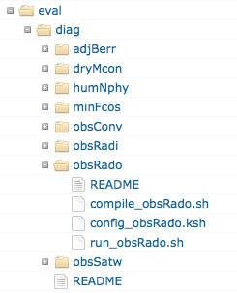
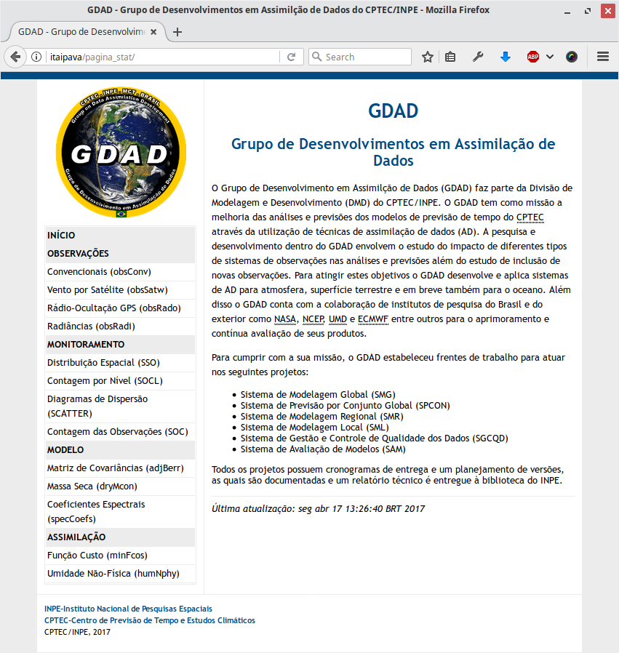
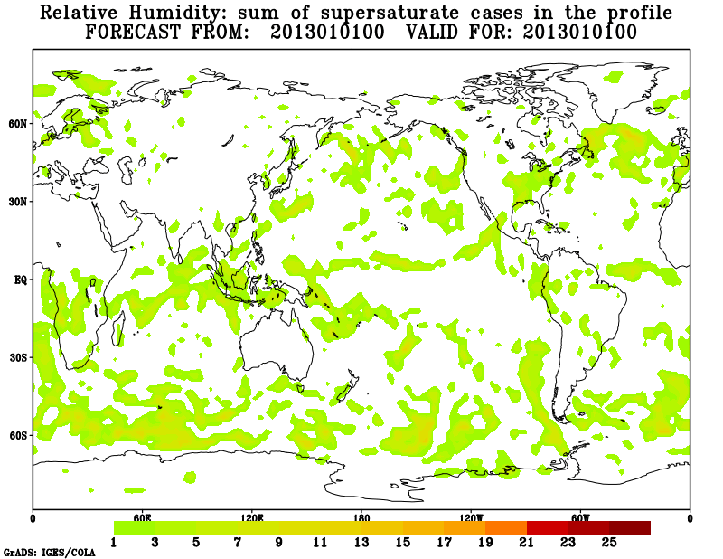
Evaluation protocol using available tools at CPTEC
“Eval” package: evaluation framework for GSI results:
Development of new versions;
Skill monitoring at the operations;
Research for continuous improvement;
Evaluation tools
available at CPTEC
Web page
For monitoring
SAI: Impact
evaluation
System (FSO)
Scripts and
programs
SCANTEC:
Community system
for NWP evaluation
(Fortran)
Specific protocol for evaluation
of each research line
STATI: Statistic
System for diagnostic data
Assimilation Process
(OmF and OmA)
(Python/Fortran )
The evaluation protocol can be explored by:
Researchers;
Post graduate students;
Operational activities;
Notes:
The EVAL package was developed for evaluating the GSI results, to be applied for
Development of new versions;
Skill monitoring at the operations;
Research for continuous improvement;
This package is included in the SMG system, in which specific protocols for evaluation of each research line is developed exploring the available tools at CPTEC, such as :
Statistic System for diagnostic data Assimilation Process (OmF and OmA) in Fortran/Python;
A NWP Evaluation Community system
Impact evaluation System based on Forecasting Sensitivity Observation method;
This results can be monitored in a web page.
This evaluation protocol can be explored by:
Researchers;
Post graduate students;
Operational activities;
in several other applications:
Regional data assimilation
Ensemble forecast using Ensemble Kalman Filter from GSI, etc

Slide 16
SMG/SMR evolution and status
SMR Version 1.0.0 (“Olympic”) 9km:
First version GSI/WRF over SA;
Simplified evaluation;
DRY MASS
CONSERVATION
CONVENTIONAL
COST FUNCTION
MINIMIZATION
SMR Version 2.0.0 (“Pilot”) 9km:
Restructuration of SMR system GSI/WRF
Simplified evaluation;
SATWIND
SMG V1.0.0
SMR V1.0.0
SMR V2.0.0
SMG Version 1.0.0 (T62L28):
Evaluation and interface correction;
Evaluation in the different categories;
First results in AMSU-A data assimilation;
NON PHYSICAL
HUMIDITY
ROGPS
SMG V2.0.0
SMG Version 2.0.0 (T299L64) :
Improvement in the GSI/BAM interface;
Radiance data assimilation from MW;
Evaluation and adjust in different category;
B MATRIX
RADIANCE
Operational
version
SMG V2.0.0
NUMERICAL INSTABILITY
NEW RESOLUTION
COMPUTATIONAL SKILL
SMG V1.0.0
March: begin
2016 2017 2018 2019 2020
SMR V1.0.0
SMR V2.0.0
Notes:
We have applied this development strategy for the deployment of the operational version of the SMG system. The first version (V0.0.0) although without radiance assimilation, it produced the first results of data assimilation using the BAM model. It was published in July of 2017. The second version (1.0.0) was published in final of 2017 and involved:
An evaluation and correction of the interface BAM/GSI;
Evaluation in different categories;
First results with AMSU-A data assimilation;

Slide 17
Next step: August 2018July2019
SMG Version 2.3.0 (T299L64):
Correction of the vertical distribution of the BAM model sigma levels;
New B Matrix from the BAM model;
Improvement of radiance Bias correction;
DRY MASS
CONSERVATION
CONVENTIONAL
COST FUNCTION
MINIMIZATION
SMG Version 2.5.0 (T299L64):
Data base expansion;
Adjusts in the GSI namelist/options;
SATWIND
SMR V2.0.0
NON PHYSICAL
HUMIDITY
SMR Version 3.0.0 (WRF/GSI):
Evaluation and interface correction;
Evaluation in the different categories;
First results in AMSU-A data assimilation;
ROGPS
SMG V2.0.0
SMG V2.3.0
SMR V3.0.0
Operational
version
SMG V2.5.0
SMR Version 3.1.0 (WRF/GSI BAM/GSI):
B Matrix update;
Data base expansion;
Adjusts in the GSI namelist/options;
B MATRIX
RADIANCE
SMR V3.1.0
Operational
version
NUMERICAL INSTABILITY
NEW RESOLUTION
COMPUTATIONAL SKILL
March: begin
SMG V2.0.0
SMG V2.3.0
SMG V2.5.0
2016 2017 2018 2019 2020
SMR V2.0.0
SMR V3.0.0
SMR V3.1.0
Notes:
A new version of SMG system was recently implemented with a horizontal resolution of T299 (roughly 40km), which is the version that should be improved to be operationalized.

Slide 18
Presentation contents
Motivation:
Objectives
Actual
Next steps to increase:
Global
Modeling system
GSI
Evaluation
system
Observation
system
Regional
Modeling system

Slide 19
New data stream strategy for data assimilation: four stages

Slide 20
Module of conversion from Bufr WMO to Bufr NCEP

Slide 21
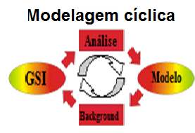
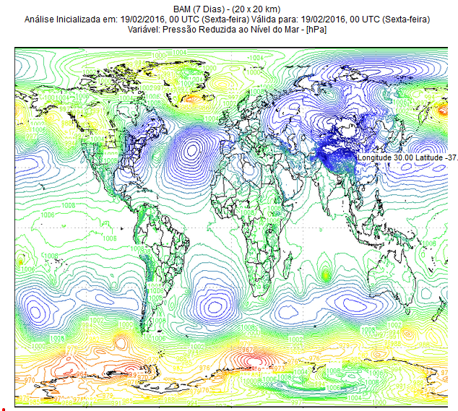
Quality control of the conventional data using PAQC code
Without
quality control
With flags of
quality control (QC)
BUFR tanque
BUFR tanque
ADPUPA
ADPUPA
AIRCAR
AIRCAR
AIRCFT
AIRCFT
PROFLR
PROFLR
ADPSFC
ADPSFC
SFCSHP
SFCSHP
SFCBOG
SFCBOG
GOESND
BAM first-guess
GOESND
GPSIPW
GPSIPW
ASCATW
PAQC: Quality control Package
ASCATW
VADWND
VADWND
RASSDA
RASSDA

Slide 22
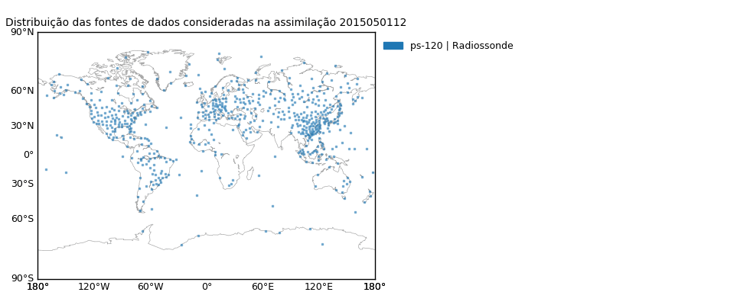
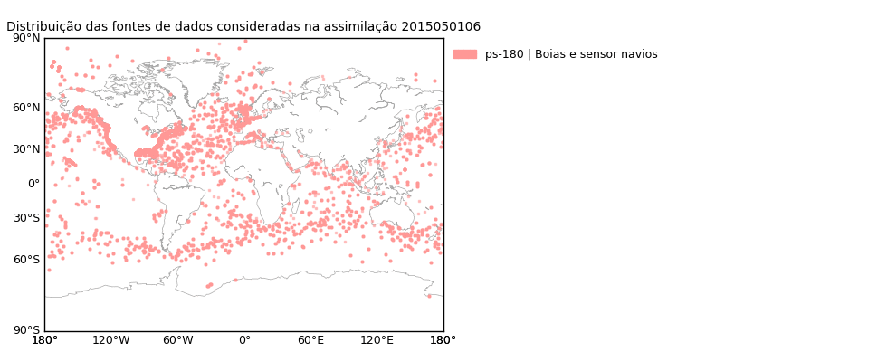
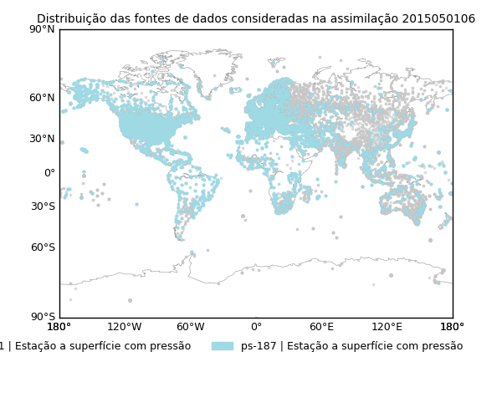
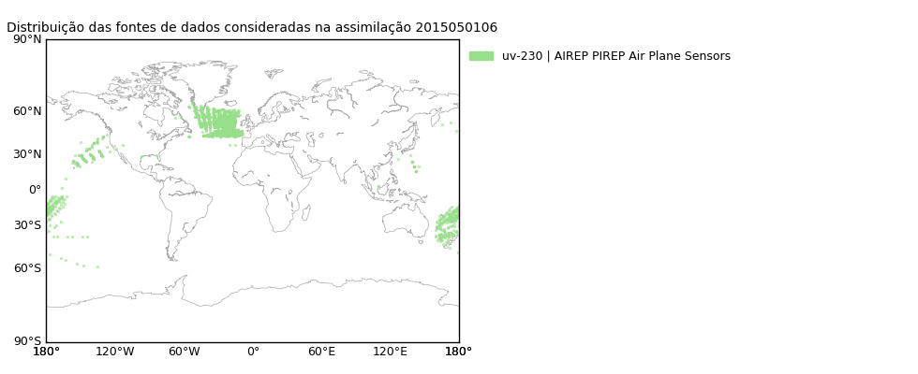
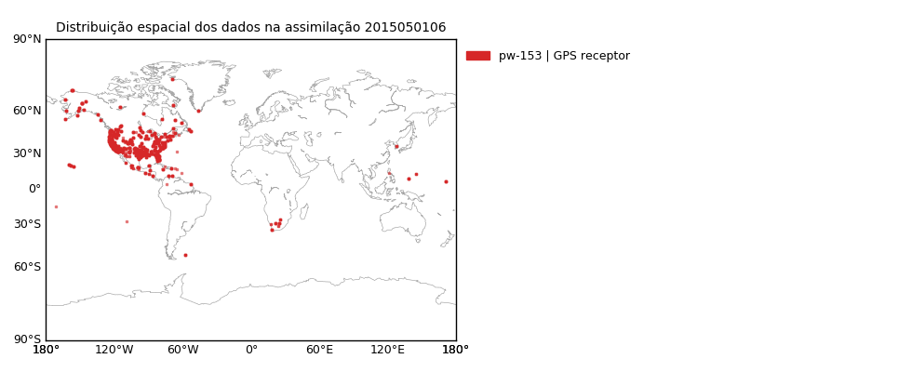
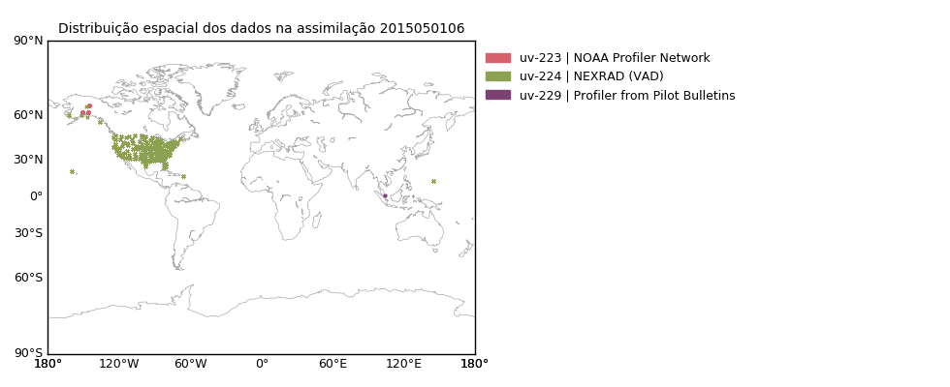
SMG operational version (V2.0.0): assimilated data overview
Conventional data assimilated
Radiossondas
Estações a superfície
Ship and Buoy
Sensores em Aviões
Estações GPS
Wind profilers

Slide 23
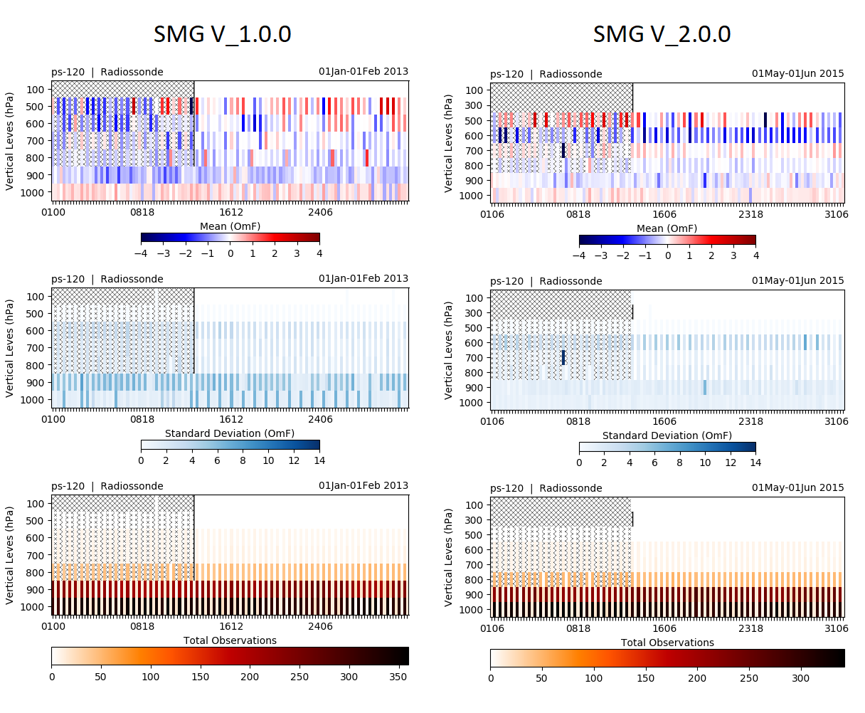
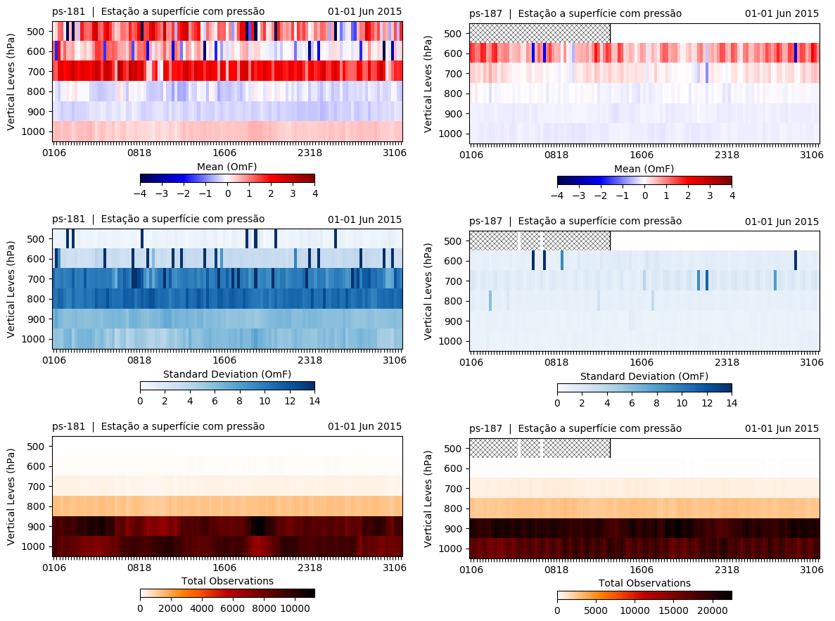
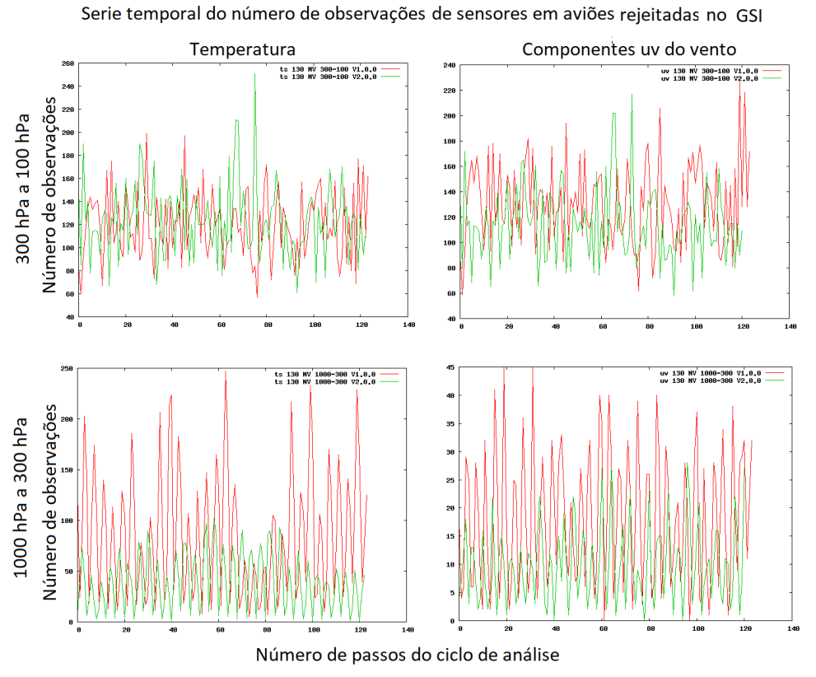
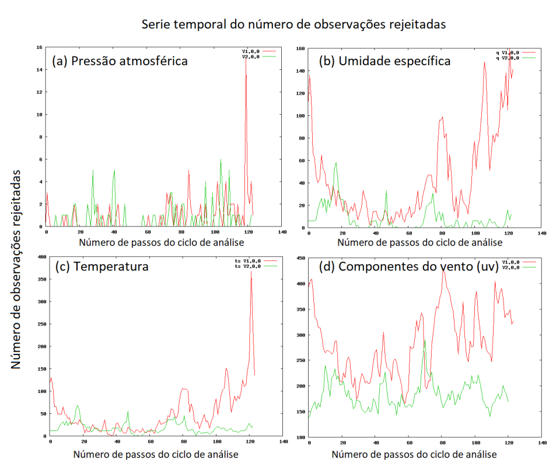
SMG system evolution: V1.0.0 Vs. V2.0.0
Radiossondes
Surface Stations
SMG V1.0.0 SMG V2.0.0
Aircraft Sensors
Ship and Buoys Sensors

Slide 24
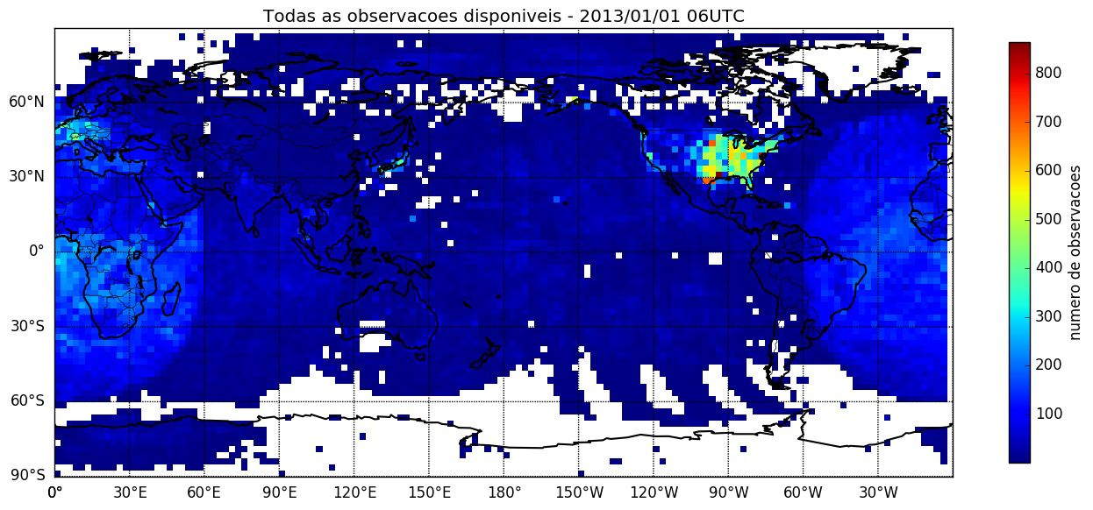
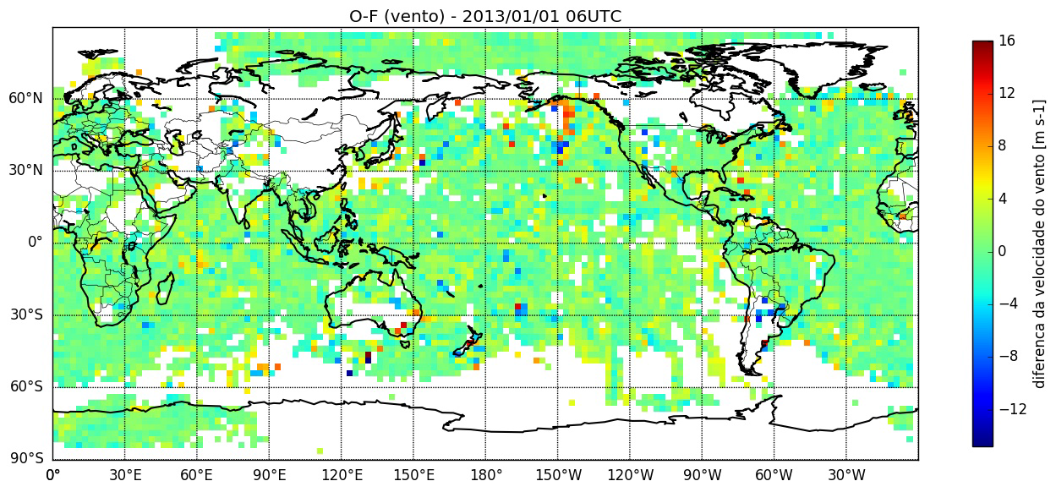
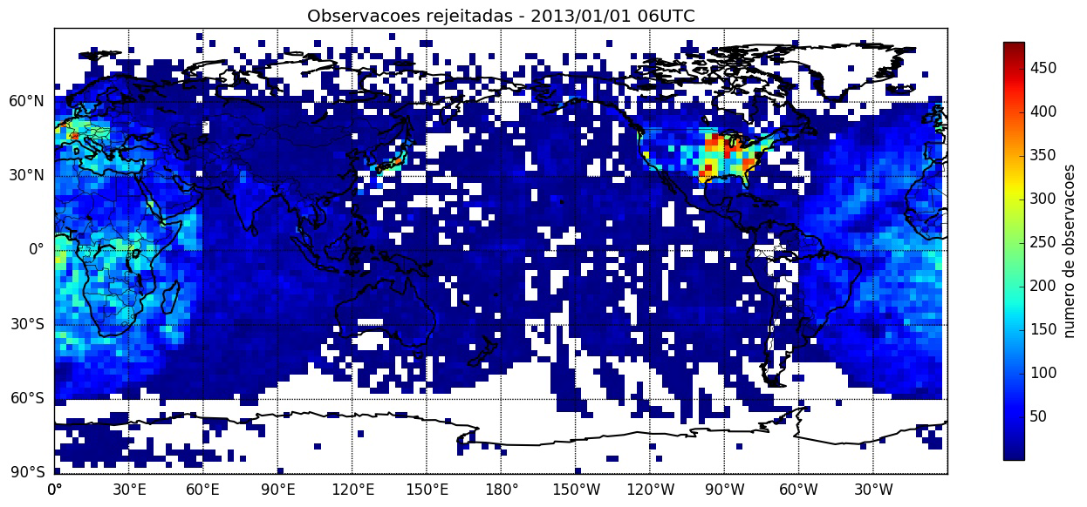
SMG operational version (V2.0.0): satellite wind data

Slide 25
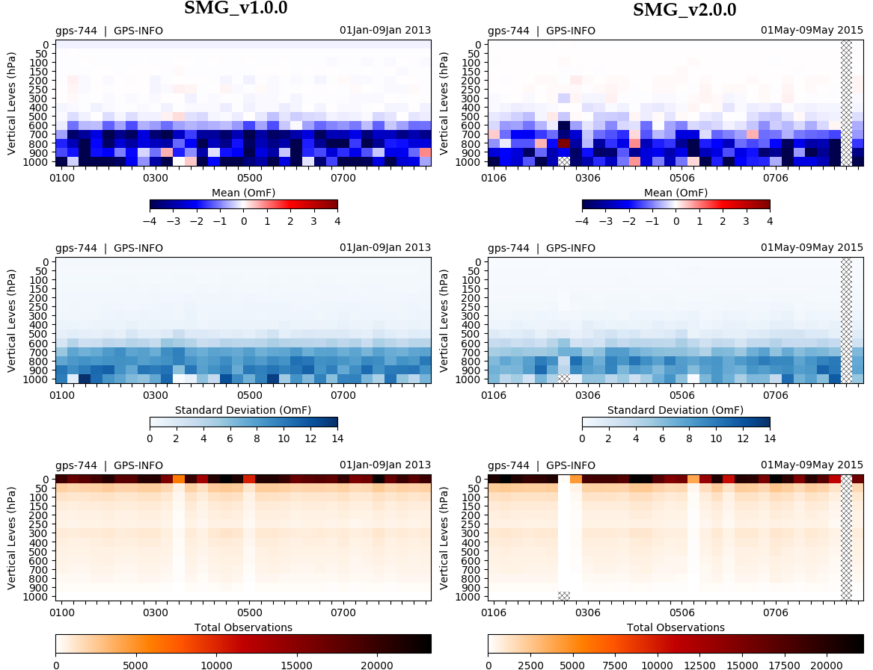
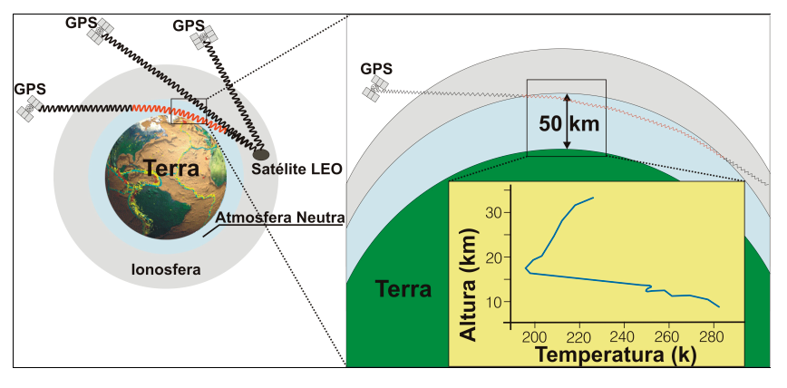
SMG operational version (V2.0.0): GNSS radio occultation data

Slide 26
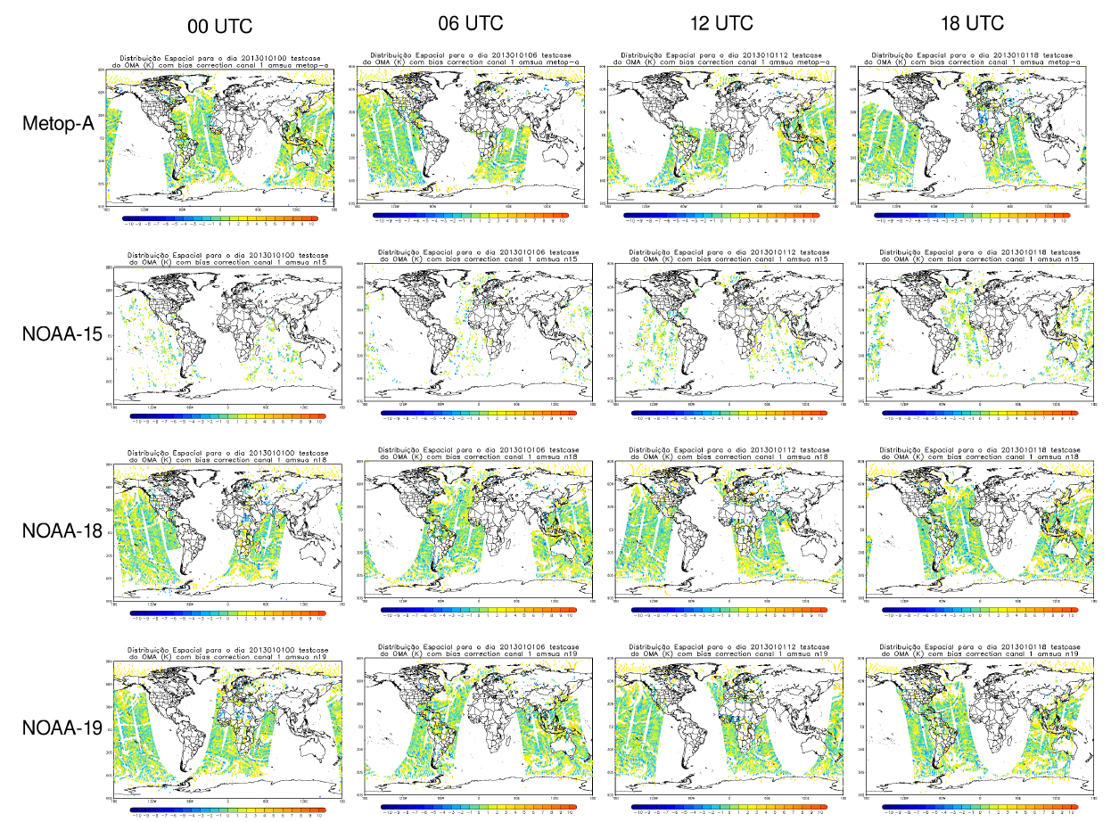
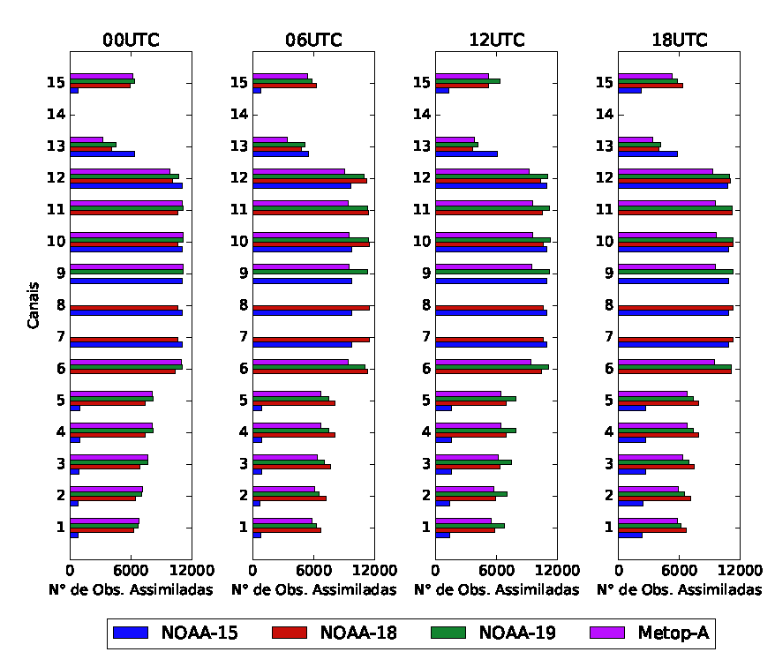
SMG operational version (V2.0.0): radiance data

Slide 27
Future plans to increase data base used
Observation systems to be included in the operations at CPTEC:
Conventional data:
IPW from GNSS receivers in ground-based;
Inclusion of data from regional data network over Brazilian territory;
Radiances: IR sensors (IASI, CRIS and other);
Satellite wind data (AMV): data from GOES R over the South America;
Radio occultation data: COSMIC-2 in special COSMIC-2B over the Amazion region;
Collaborations:
ECMWF collaboration in the following topics:
Exchange of observations from regional data network;
Evaluation tools for data assimilation products;
Explore the MARS systen and provided functionalities;
NOAA/NCEP collaboration in the following topics:
GSI developement and configuration for operational aplications;
Data provide in real time for data assimilation at CPTEC.

Slide 28
Thanks for your attention
Thank you for inviting CPTEC to participate in the GODEX-NWP meeting. We hope to be phisically presente in the next meeting.
Questions and comments?

Slide 29
CPTEC HPC overview
1994: NEC SX-3
1 node, 1 processor;
512 MB of RAM;
3.1 Gflops of peak performance;
20 GB RAID disks;
48 GB SCSI disks;
1998/1999: NEC SX-4
1 node, 8 processors;
16 GB of RAM;
67 GB RAID disks;
220 GB SCSI disks;
2002-2004: NEC SX-6
12 nodes, 8 processors (96 total);
768 GB of RAM;
768 Gflops of peak performance;
16 TB FC disks;
2007: SUN cluster
275 nodes, 2 dual core processors (1,100 total);
2.2 TB of RAM;
5.7 Tflops of peak performance;
72 TB of storage;
2010: Cray XT6
1,272 nodes, 2 12-core processors (30,528 total, 17,472 current);
39.75 TB of RAM;
16.6 Tflops of peak performance;
866 TB of primary storage;
3.84 PB of secondary storage;
6.0 PB of tertiary storage;
2018: Cray XC50
4,160 cores – for operational use only.

